Slide 1
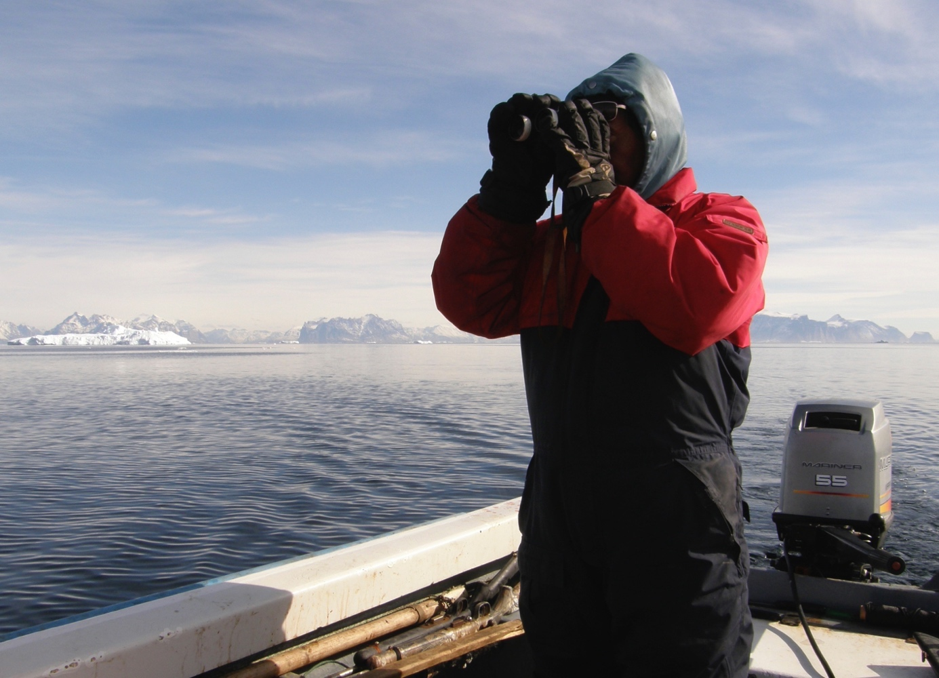
Capardus
Work Package 2
Case study: Greenland

Slide 2
WP2 Case study Greenland
Aims Establish dialogue and collaboration related to development of guidelines and standards, and organize workshop and research school
T2.1 Dialogue w. Greenland actors
T2.3 Research school, techn. for sust. development

Slide 3
WP2 Case study Greenland
T2.1 Dialogues w. Greenland actors
Interviews and dialogue:
Natural resource user groups (community members, KNAPK)
Government agencies (Qeqertalik, Avannaata, Ministry of Fisheries and Hunting, Ministry of Nature)
Scientists (GN, Ilisimatusarfik)
Purpose of dialogue: To develop guidelines/standards for CBM, sought aligned with similar development in other regions
Lead by NORDECO
CBM = Community Based Monitoring

Slide 4
WP2 Case studies Greenland
Lead by NORDECO
T2.3 Research school
Participants: Civil society organisations, community members, gov’t agencies, scientists
Lectures and discussions on technologies and standards for CBM programs and resource management in Greenland
In Aasiaat, timing TBD
CBM = Community Based Monitoring

Slide 5
Challenges and interventions in linking bottom-up and top-down observing (From Hajo Eicken et al. 2021) https://academic.oup.com/bioscience/article/71/5/467/6238581?login=true

Slide 6
WP2 Case study Greenland
Activities June – Dec. 2021
Guided CBM work of community monitoring group and local authority
Continued learning and adjustment of CBM approach
Dialogue continued with KNAPK and other actors, PISUNA-net actions agreed
Polar Cluster Projects Zoom Chat
Greenland Science Week, CBM Book Launch, 50 persons
Other:
- Routledge book chapter
- Annual Review Env. and Natural Resources
- Nature Reviews Primer Methods Box on Citizen Science
- Assessment of 330 proposed CBD Indicators with UNEP-WCMC
A total of 2,500 downloads BioScience Special Section
Plans next 6 months
Guided CBM work and dialogue continued
PISUNA-net actions continued towards Gov’t executive order
Research school Aasiaat timing to be decided

Slide 7
Digital platforms in CBM programs, Flow of data and intended users (From Noor Johnson et al. 2021) Link: https://academic.oup.com/bioscience/article/71/5/452/6236037?login=true
PISUNA-net
Local language / Photos / Advocacy strategy
https://eloka-arctic.org/pisuna-net/en

