Slide 1
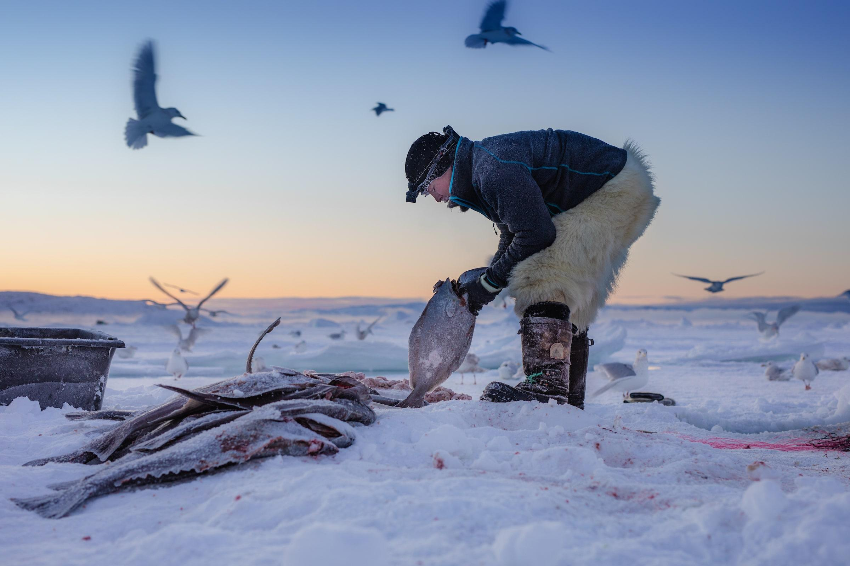

Tracking social-ecological systems using Bayesian Belief Networks; a case study from inshore halibut fisheries in Greenland
Roel May, Martin Nielsen, Birger Poppel, Henrik Meilby

Slide 2
Background
The Arctic is undergoing the most rapid changes in the climate system worldwide
  higher risk of extreme events
  changes in the access to the Arctic resources
Along the coast of Greenland, most people living in smaller settlements depend partly or entirely on hunting and small-scale fishing
  vulnerable to the effects of climate change on natural resources and may suffer material and wellbeing deprivation
  offering new opportunities for communities and for economic development related to exploration of natural resources
Local ecological knowledge and scientific evidence have at times clashed, and management of Greenland's natural living resources has become highly politicised
From this perspective, management for sustainable resource exploitation needs to build on integrated knowledge on environmental, technical, social and political characteristics

Slide 3
Rationale
Novel technologies may be important for collecting and integrating data, developing knowledge-based planning and informed decision making
One such technology is use of Bayesian Belief Network (BBN) models offer the ability to explore such complex systems with limited data availability by including various forms of data – including expert knowledge and consumer preferences
This enables policymakers and resource users to explore the outcome of various policies under different scenarios including impacts on living conditions and quality of life
Showcase such an approach by developing a “toy model” which visualizes a real-life case for natural resource challenge focusing on inshore halibut fisheries
Develop the online app surBayes to capture the model and stakeholder data

Slide 4
INSHORE SUBSYSTEM
OFFSHORE SUBSYSTEM
Equipment support
Inshore standards
Market demand
MSC certification
Lifestyle
Governance
Quota Offshore
Quota Narwhal
Landing capacity
Quota Inshore
Pricing
Fishing technique
Fleet Inshore
Fleet Offshore
Income
Fishing capacity
Income
Socioeconomics
Traded catch
Narwhal catch
Halibut catch
Subsistence
Traded catch
Narwhal numbers T0
Narwhal numbers T1
Sea ice
conditions
Halibut recruitment
Halibut offshore
Environment
Switch
Input
Decision
Output
Halibut numbers T0
Halibut numbers T1
Climate change

Slide 5
Activities
Construction of the BBN model for inshore halibut fisheries
Stakeholder interviews & data/information solicitation
Development of the surBayes app (currently under internal review)
Presentation & workhop at the Greenland Science Week
Upcoming deliverable: Description of work in handbook / hand-outs
Research school contribution?

Slide 6
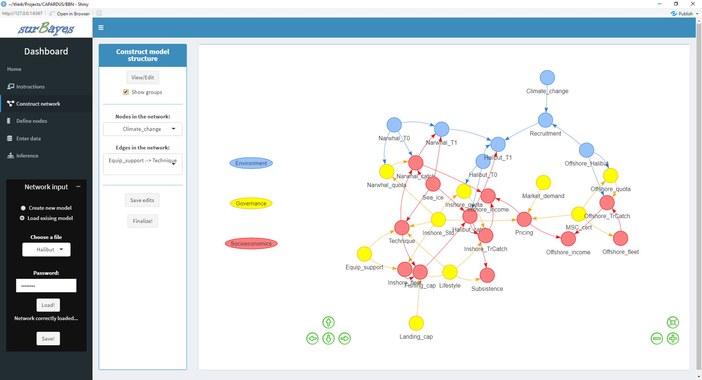

Slide 7
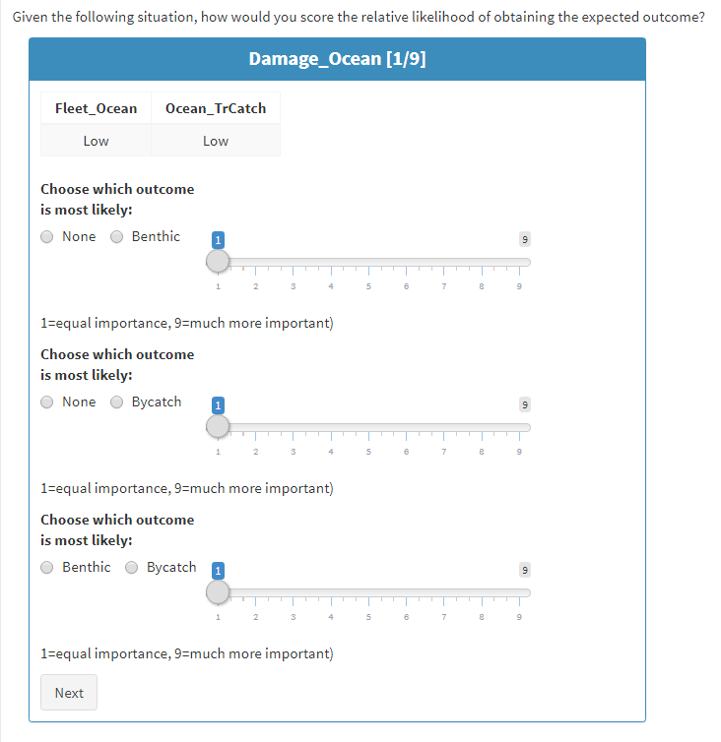
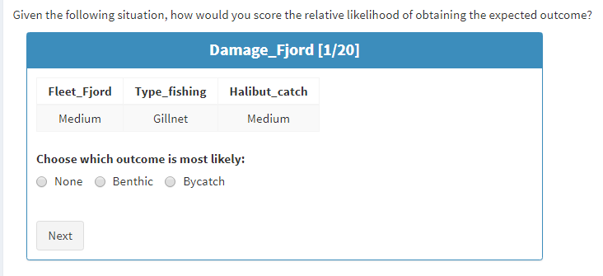
Filling out the survey…quickly…
Enter what you «believe» is the best answer given the conditions at the top.
All other aspects may be considered to be able to vary unlimitedly; there are no inherent assumptions.

Slide 8

Scenarios and inference
Global demands (SDG 1, 10)
Climate change (SDG 13, 14)
Regulated communities (SDG 2, 12)

Slide 9
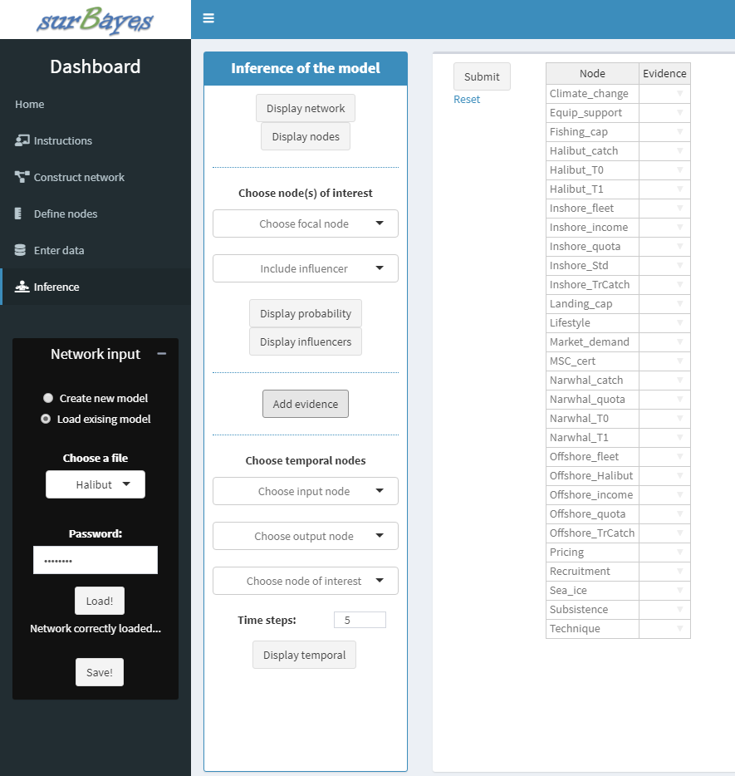


Slide 10
Scenario switches
Global demands | Climate change | Regulated communities
Market_demand = High MSC_cert = No Inshore_std = No Equip_support = High Landing_cap = High Offshore_quota = High Inshore_quota = High | Sea_ice = Ice_free Landing_capacity = High Fishing_capacity = High Offshore_fleet = High Inshore_fleet = High Technique = Cutter | MSC_cert = Yes Inshore_std = Yes Offshore_quota = Low Inshore_quota = Low Narwhal_quota = Low Equip_support = Low

