Slide 1
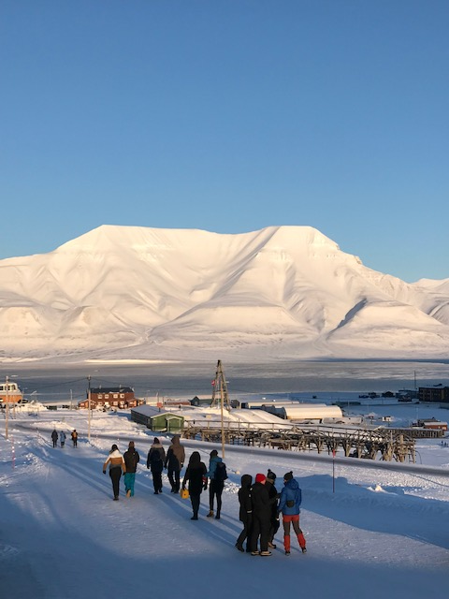
Svalbard: Community based monitoring and citizen science: collaboration with local communites and authorities Activities: Fall 2021 CAPARDUS-Progress Meeting January 13 2022 Lisbeth Iversen, NERSC, PhD candidate AHO

Slide 2
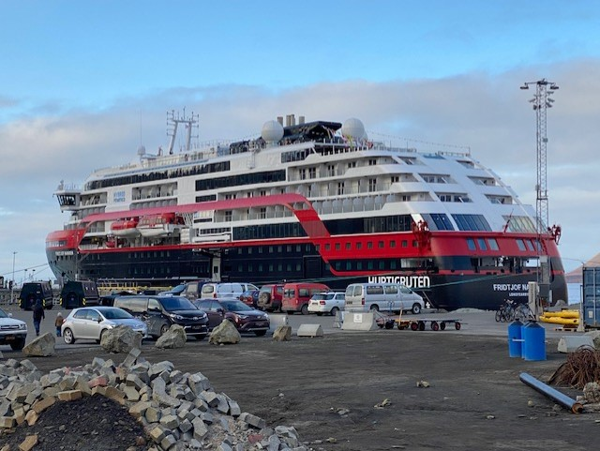
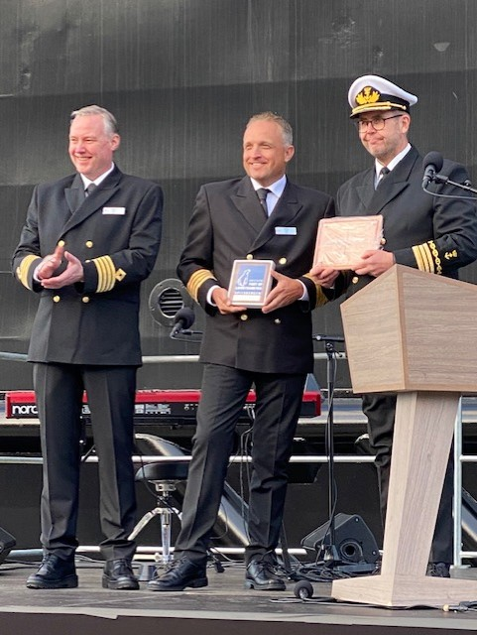
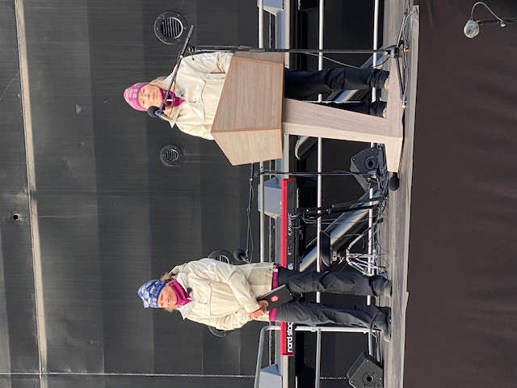
September 13. Meeting with local stakeholders/ SSSI network in Longyearbyen
September 14. Invited to participate in the baptism of Hurtigruten Expeditions' hybrid-powered expedition ship MS Fridtjof Nansen in Longyearbyen. Hurtigruten has installed a unique research facility, and is planning on connecting up to 70 scientists to their research activity. Scitizen Science programs are important in this.
I was invited to participate in this formal event as well as the dinner at the Funktionærmessen restaurant after the ceremony. Hurtigruten Svalbard, together with the rest of the Hurtigruten group, hosted the event, which marked a double 125th anniversary. Important networking arena.

Slide 3
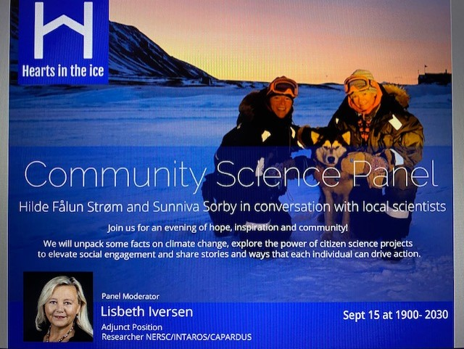
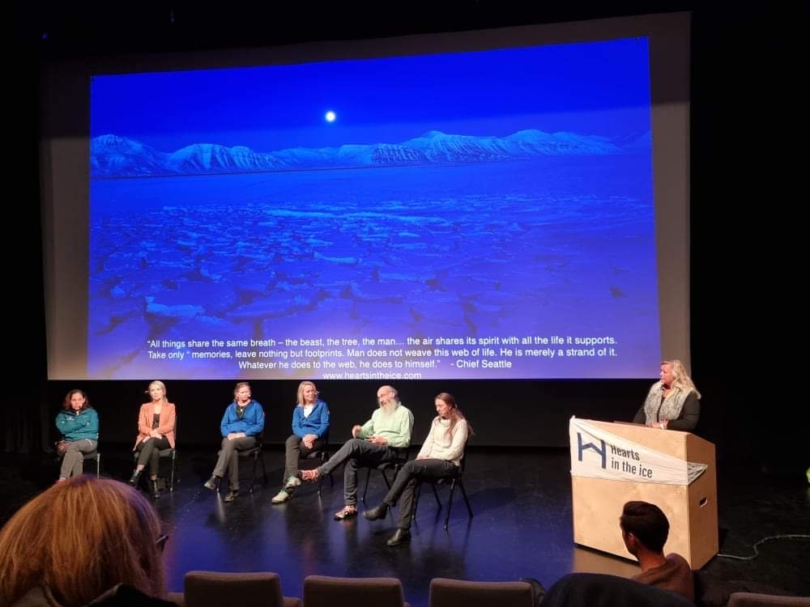
September 15. Community Science Panel in Longyearbyen. The first time such an event was taking place here. This was an initiative by Hilde Fålun Strøm and Sunniva Sorby, partners in the citizen science project Hearts in the ice:
https://www.heartsintheice.com/?lang=no
Here is the link to the event I was invited to moderate
https://drive.google.com/file/d/1hetwwNwSWcggpeAI4VKWTeSzVDJwA6sH/view

Slide 4
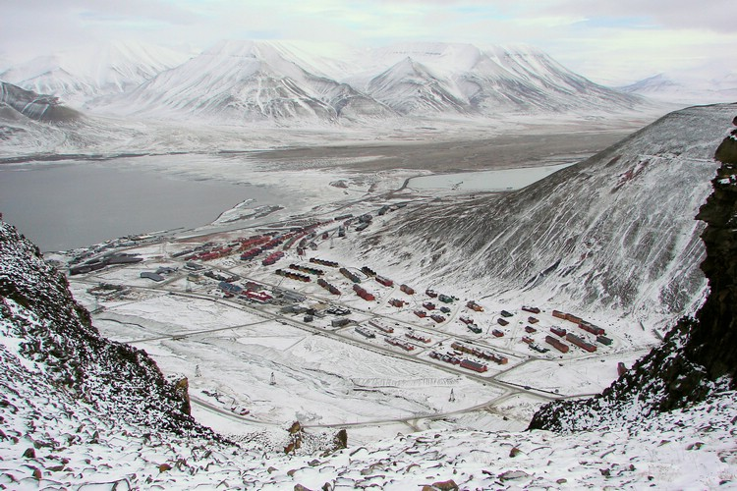
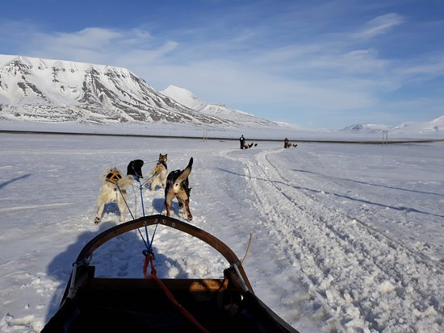
CAPARDUS;
Case Longyearbyen and Adventsdalen
Collaboration with the local council and the inhabitants on capacity building-Peoples walk and workshops- Spring 2022
The Governor has started working on a protection plan for Adventsdalen, an area that is used by the local community and the tourist industry.
Participation and cocreation on mapping areas of public interest, worries, identifying need for knowledge and data for decision-making are areas of collaboration.
Cultural heritage should be one of the important topics to address!

Slide 5
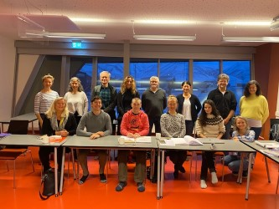
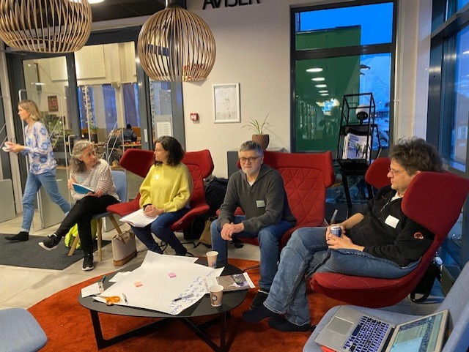
October 29-31
Leading a workshop in Longyearbyen with invited researchers, members of the SSSI and other outreach activities. Funded by Svalbard Strategic Grant.
Saturday October 30
Dissemination Event I - “Living library” with coffee and mingling - Research needs and topics - co-creation lab - Poster exhibition - Paper peep show.
18:00 - 20:00 Longyearbyen Folkebibliotek
Dissemination Event II - Panel discussion with Line N. Ylvisåker I participated in the panel.

Slide 6
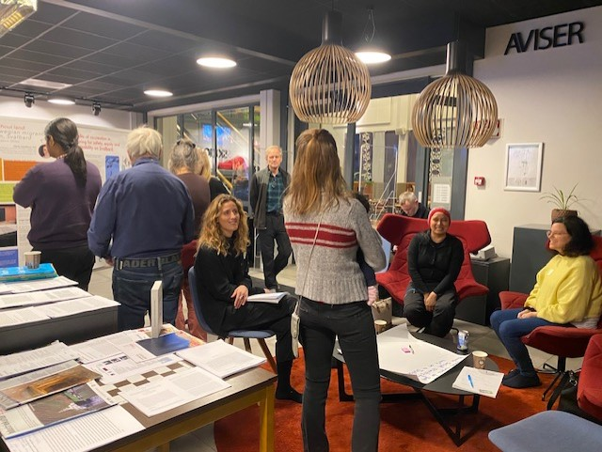
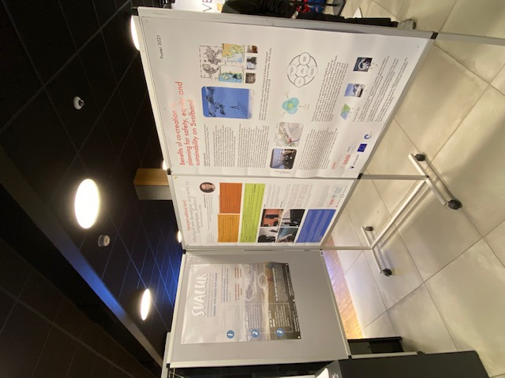
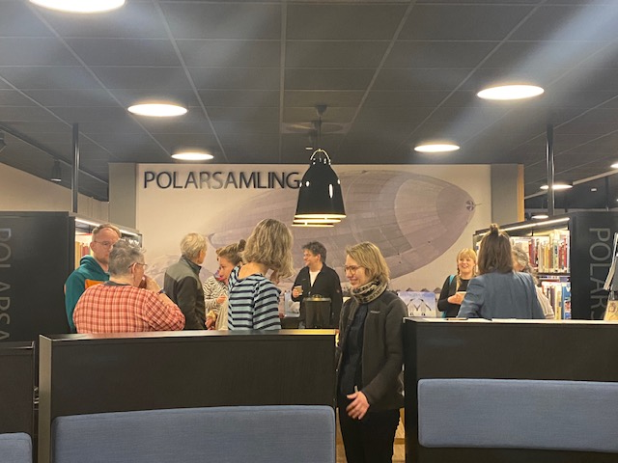

Slide 7
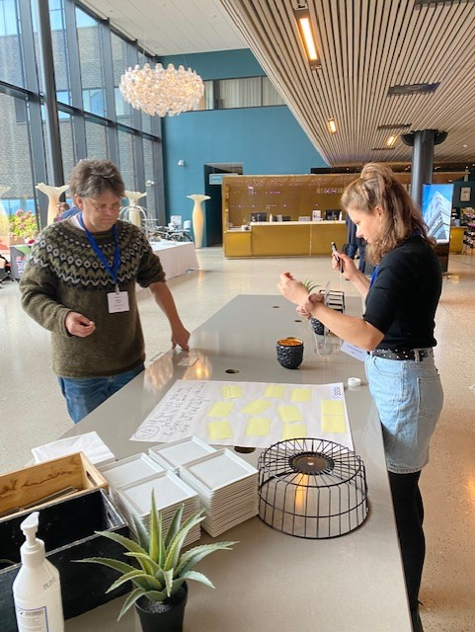
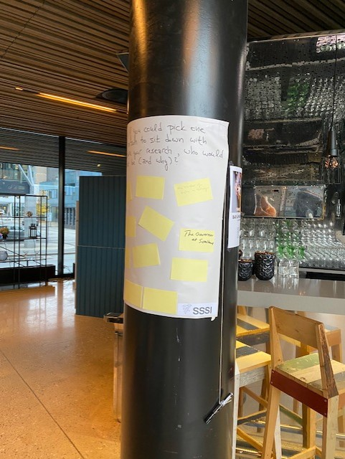
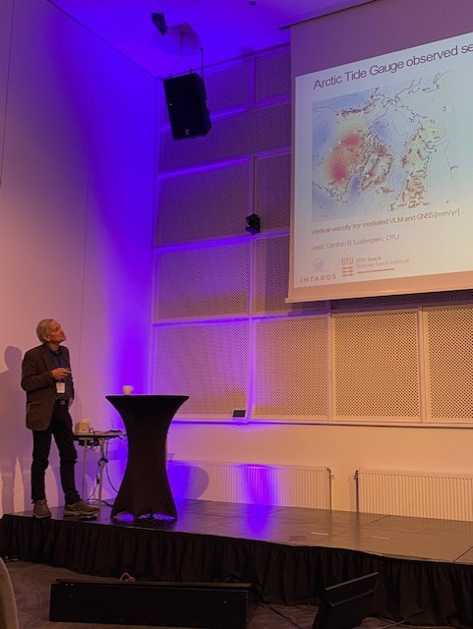
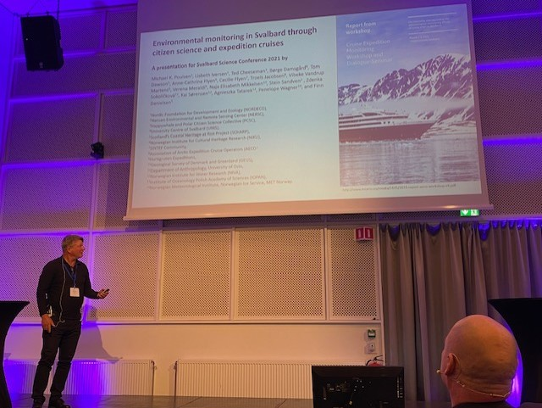
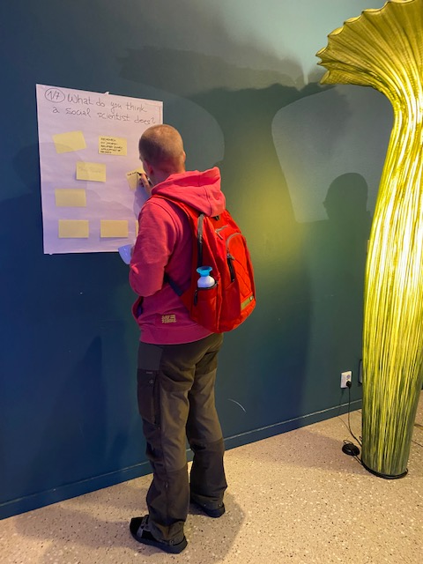
November 2-3
Participation with presentations, and poster by the SSSI group and individually, at Svalbard Science Conference in Oslo.

Slide 8
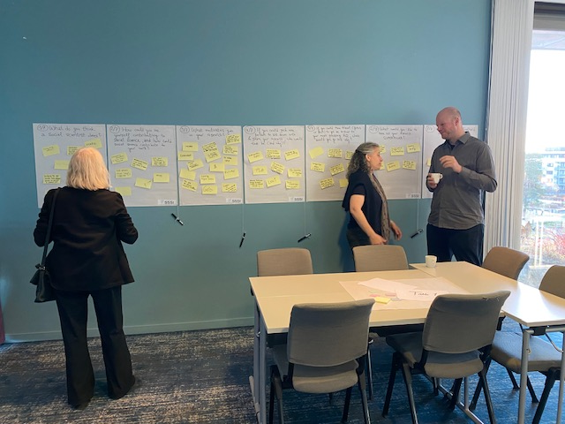
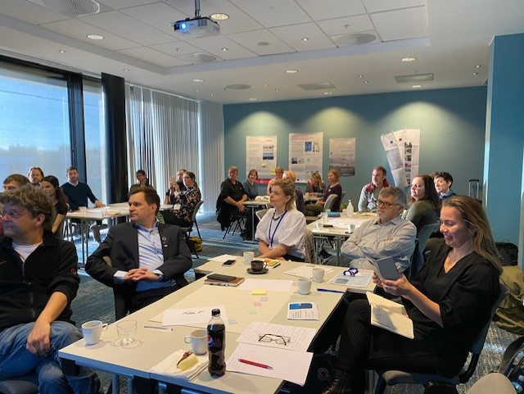
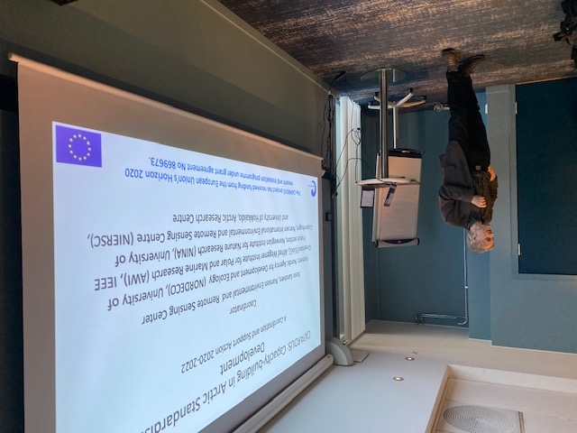
November 4
Side meeting to the SSC, hosted by me and the board of SSSI in Oslo
Grant from Svalbard Strategic Grant. Workshop across different research groups to write a proposal to Horizon Europe etc.
Coordination and Support Activity Support for Network-related Activities Catalyzing
Title: Interdisciplinary perspectives across social and natural science on Svalbard

Slide 9
January 2022:
Ongoing -Initiative to write a proposal to The Norwegian Research Coucil, NFR.
2 Workshop reports in the writing
APS: Engaged in the first steps in the design of the Arctic Practices System, both in the survey, and by sharing the survey with members of the Svalbard Social Science Initiative

Slide 10
Thank you for your attention!

