Slide 1
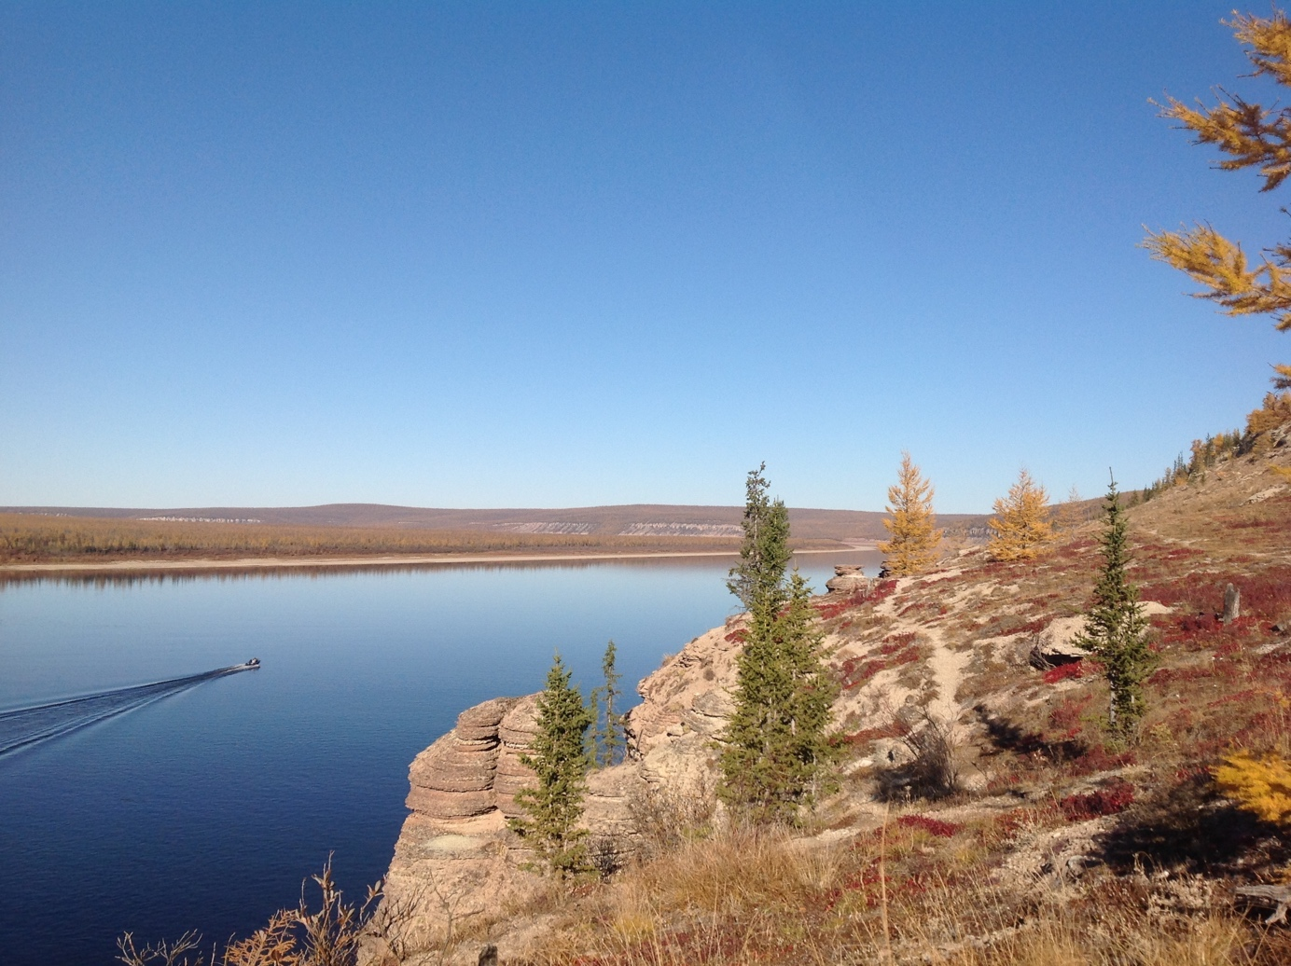
Capardus
Work Package 4
Case study: Russia

Slide 2
WP4 Case study Russia
Aims Establish dialogue and collaboration related to development of guidelines and standards, organize workshop
T4.1 Dialogue w. indigenous communities and other actors on living resources in Yakutia
T4.2 Workshop on capacity-building and development of standards w. indigenous communities

Slide 3
WP4 Case study Russia
Lead by NORDECO and CSIPN
T4.1 Dialogue w. local communities and actors on living resources in Yakutia and Murmansk area
Interviews and community meetings
Document and map indigenous knowledge and observations of development and living resources, based on already existing community groups who are monitoring the environment (CBM)

Slide 4
WP4 Case study Russia
Lead by NORDECO & CSIPN
T4.2 Workshop on capacity-building and development of standards with indigenous communities
Participants: 12 Indigenous representatives from across Arctic Russia
Moscow, Feb.-March 2022 (proposed)
Purpose of workshop: To discuss current information system for CBM related to Arctic development and living resources. Discuss new observing and communication technologies, and in what way standardization might assist. Enhance the capacity of IP groups in use of new technologies.

Slide 5
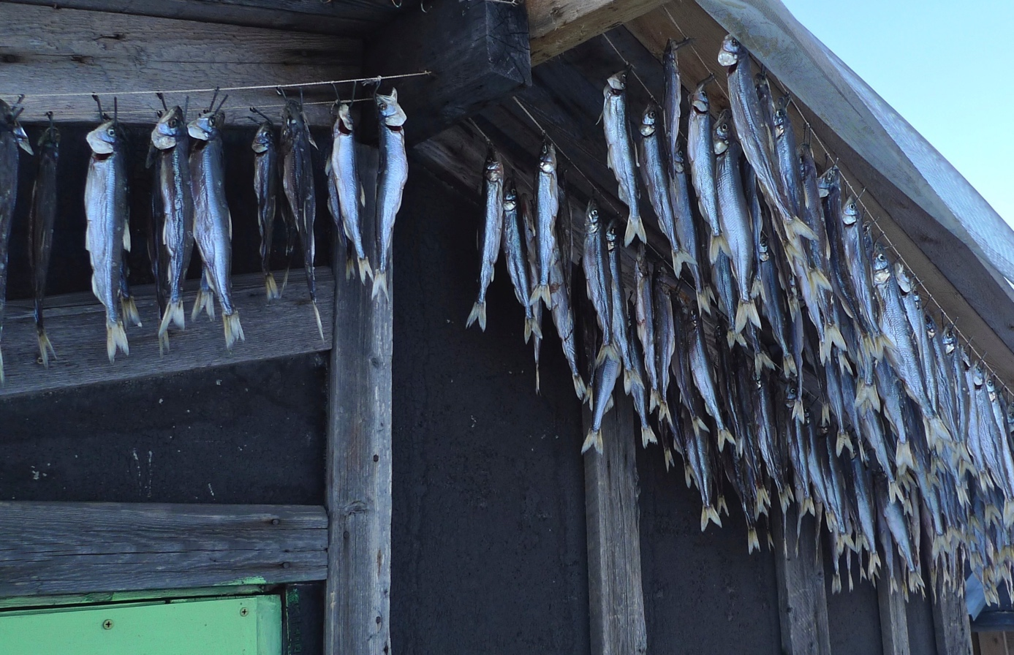
Deliverables
D4.1 Report on interviews Yakutia* (NORDECO/CSIPN, Nov. 2020)
D4.2 Workshop Moscow report (NORDECO/CSIPN, May 2022)
*Incl. requirements for Arctic Best Practices System in Yakutia

Slide 6
Progress June – Dec. 2021
Updated activity plans Yakutia and Kola Sapmi
Eight groups actively monitoring resource trends
Guidance of the community monitoring groups
Continued learning and adjustment of approaches
Experience Exchange workshop btw Yakutia and Kola Peninsula CBM groups in Murmansk, Nov 2021
Discussions w/Bikin Indigenous Peoples’ group
Dissemination:
Regular inputs to natural resource management decision-making Yakutia
CBM Training Guideline
”CBM in the Arctic” book translation into Russian
Case study ”Citizen Science Fragile Areas”, INTAROS booklet
Other:
Assisted Russian IP activities in Wayfinder projects
Arctic Practice questions, answers from three communities

Slide 7
Plans for the next 6 months
Community groups continue monitor resource trends
Continued guidance of the groups
Further learning and adjustment of approaches
Moscow experience exchange workshop
Arctic Practice questions, dialogue with the coordinators
D4.1 Report on interviews w. users and stakeholders Yakutia (postponed from M12). Timing: Depends on travel restrictions
D4.2 Report from workshop on capacity-building, CBM and standards (postponed from M30). Timing: Proposed completed May 2022

